Slide 1
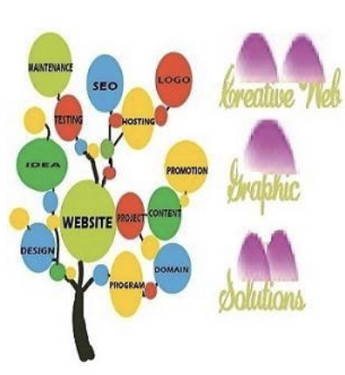
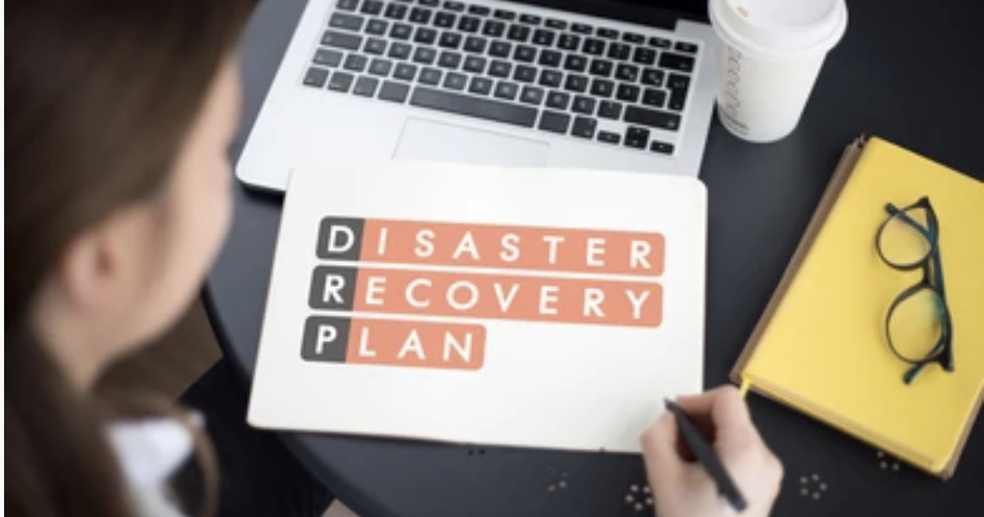
Caption
By
Creative Web Graphic Solutions LLC

Slide 2

Overview of the Product
One of the best ways to protect your organisation from disaster is to implement disaster recovery plan. Our product protects all kind of disasters like natural or man-made accidents. It has been designed as easy to follow and customised to meet the needs of the organisation.

Slide 3
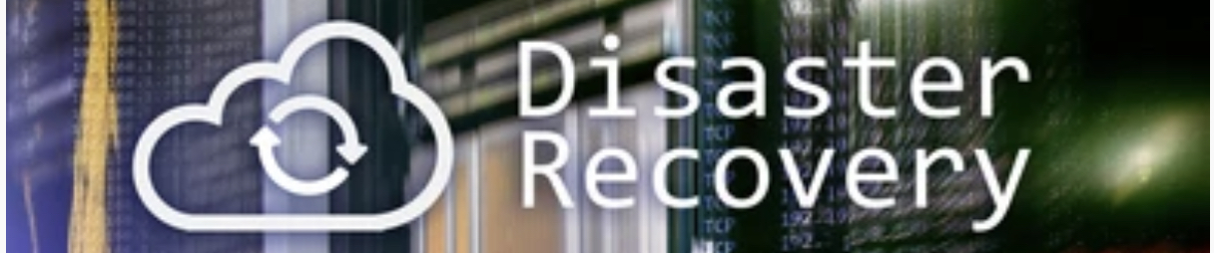
Concept of DaaS
Disaster Recovery Management Tool provides the best user experience for the organisation can continue to operate in the event of an emergency or failure. It makes the high availability of infrastructure design on the cloud that keep the IT operations up and running smoothly. This SaaS based web application can automate the replication that asynchronously replicates workloads in the on-premise environment by one-click orchestrated recovery solution. The data replication process makes the copies are sync that the data is usable after the failover.

Slide 4
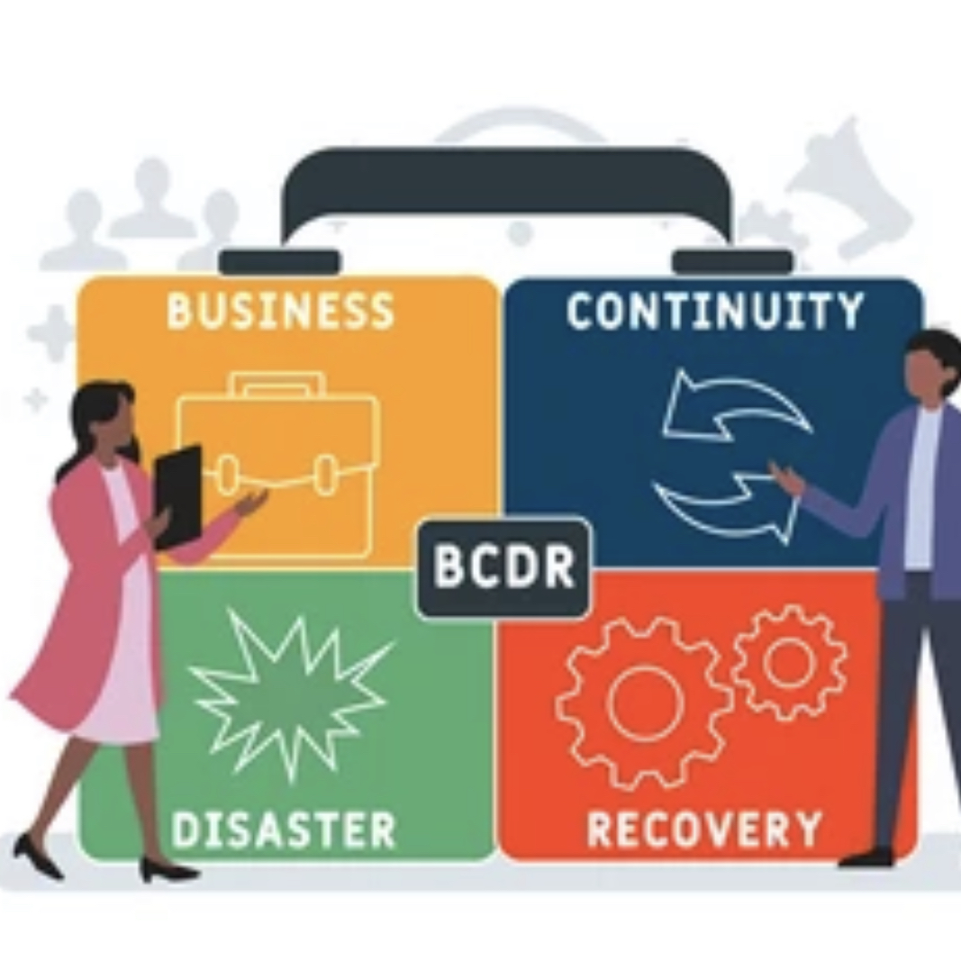
Problem Identification
Disaster Risk : It includes natural disaster, techniques related to incidents and man-made disasters. So, organisation need to follow the recovery strategy and resource required to recover from disaster.
Determining the critical Application and Resources: The organisation evaluate the business process to determine which are critical to operations of the organisation. It includes short term, long term functioning capacity and recognise the processes that should not be delayed.
Backup and Storage Procedures: These procedures should identify the things to backup, by whom and how to perform the backup, location of backup and how frequently backup should occur. All critical applications, equipment and documents should be backed up.

Slide 5
Problem Identification
Maintaining DRP: DR planning is a continual process as risks of emergencies and disasters are always changing. So, the organisation has to test routinely and evaluate the procedures documented in the plan for effectiveness and appropriateness.
Disaster Recovery Team: DR team is responsible for developing, implementing the features and maintaining the DRP. It is also define the responsibilities and should be contacted in the event of disaster or emergency.

Slide 6
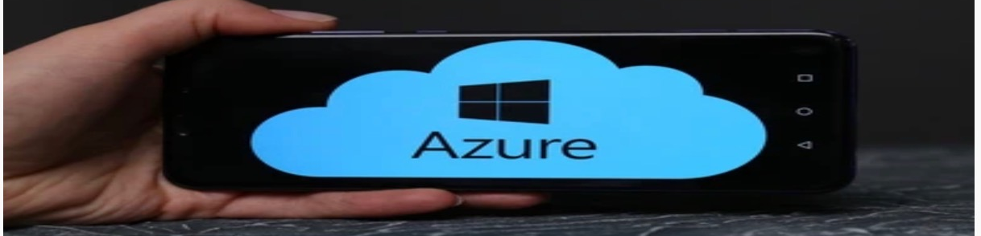
Set of Tasks in Azure
Replicate Failover : If there is an outage that occurs on-premises and fail the replicating machines over to Azure. Azure VMs are created with replicated data. Failover creates and brings Azure VMs to the selected recovery point. When on-premise site is running as normal that specifies the failover from has been done successfully.
Recover Workloads: The organisations operating on infrastructure of servers can be migrated these workloads to Azure. The common practice is to make the failover and move servers to Azure.
Deploy Resources(Files/Documents/Pictures): The organisation customise the resource deployment for any scenario to limit the data loss that works around clock. Backup the point-in-time to any storage or cloud that save the production environment.

Slide 7
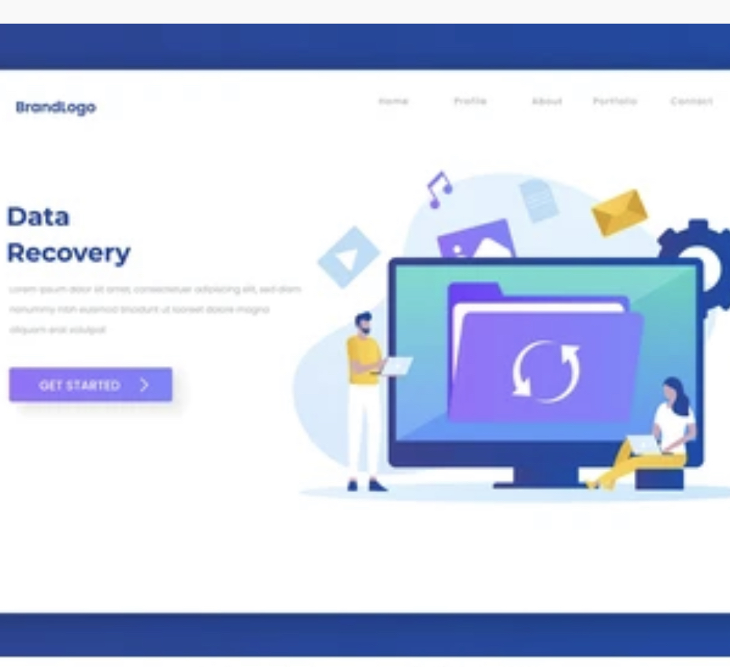
Set of Tasks in Azure
Website Recovery: It replicates the workload running on physical and VMs from primary site to a secondary location. This can be used in cloud and hybrid cloud architectures. When we integrate the automation runbooks and traffic manager, the RTO will be further reduced.
Severe Weather: It is the machine learning prediction of weather to process the satellite imagery data for the near real time analytics. The deep learning models responds to catastrophic events and provide the warning signals for the recovery.

Slide 8

Disaster Recovery Plan
Power Outages : When there is an outage, the organisation needs to take various measures like infrastructure testing and backup data with ample power supply access. These include local backup power systems, spare power supply for equipments and devices in the on-premise environment.
Human Error: This strategy ensures that the protection of valuable asset of our data. The sensitive data you may be holding about your clients. We need to recover all the files including pictures, videos, audios and documents etc.,
Server Issues : This team is responsible for the area of recovery in IT infrastructure including server, storage, databases and networks. Azure VMs are created with replicated data. The replication of workload used in cloud and hybrid cloud architecture.

Slide 9

Disaster Recovery Plan
Unexpected Updates : This role is to monitor the application activities should be implemented based on a restorative plan. It includes application integration, application settings, configuration and data consistency.
Severe Weather: When the company has been observed the severe weather in the organisation, Our disaster recovery plan take the immediate steps to restore the critical business systems, operations and the long-term plan for full recovery.
Fire Damage : The backup and DR solution is a starting point in case of fire damage. With the right infrastructure and backup schedule, companies can restore their backups and replicate in different location faster in case of emergency in primary data center.

Slide 10
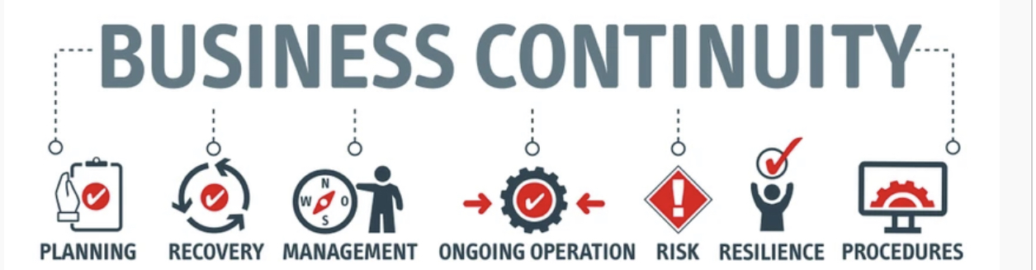
Product Launch (MVP)
Our Business continuity plan layout the critical aspects of business operations and protect in the event of disaster. The following most valuable assets has to be protected like Servers, Network connections, online systems and business related applications during the disaster. Also, it saves you from damaging your data, harming your reputation, customer relationships, revenue loss and business vitality.

Slide 11
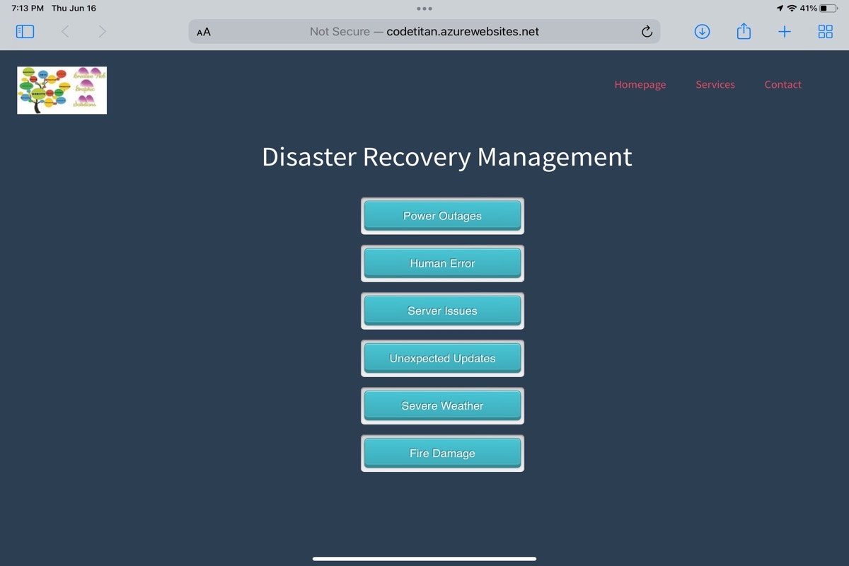
Product Page
Caption

Slide 12


